Slide 1
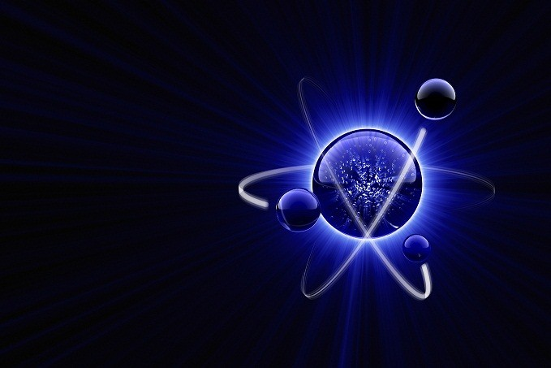
Just Atoms (Blueberries)

Slide 2
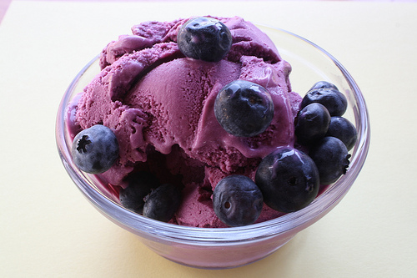
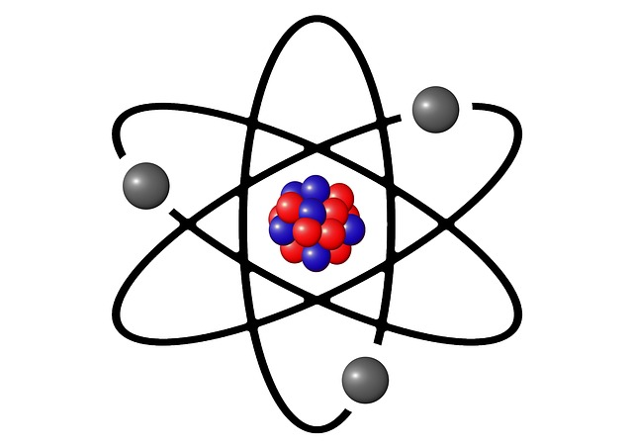
"Blueberries are essential for our health. One must never underestimate the power of the blueberries. After all, they give us an absolutely delicious ice-cream. Meow."
=

Slide 3
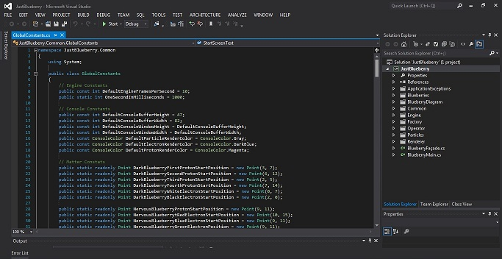
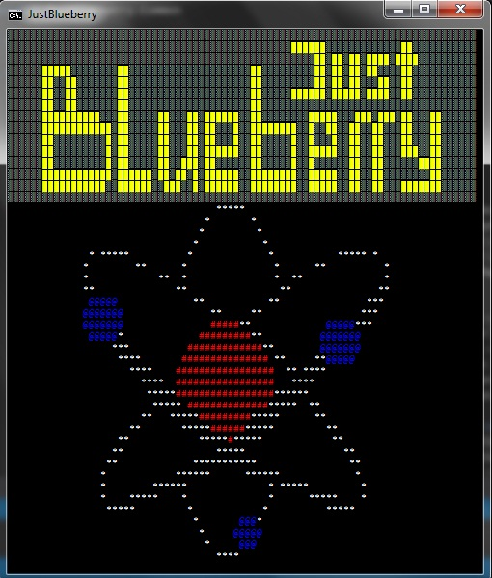
Just some pictures

Slide 4
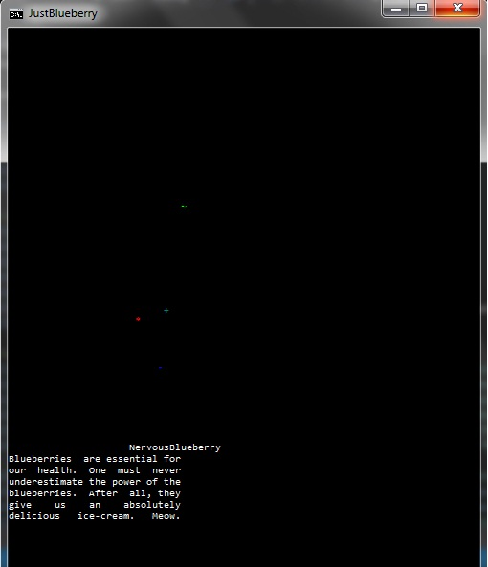
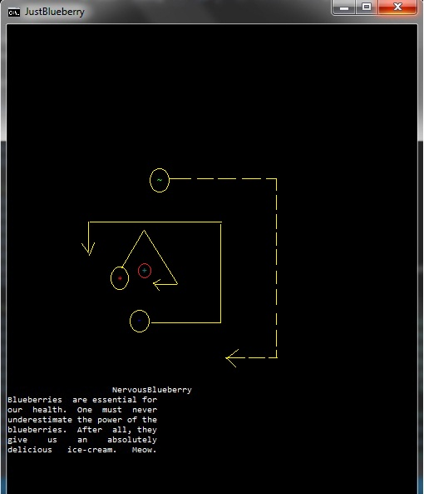
How does it work…

Slide 5
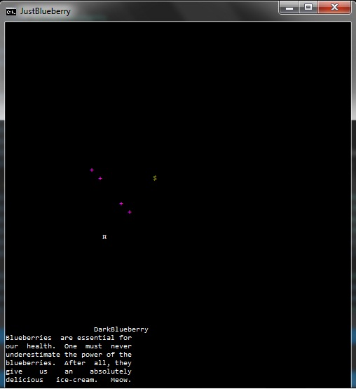
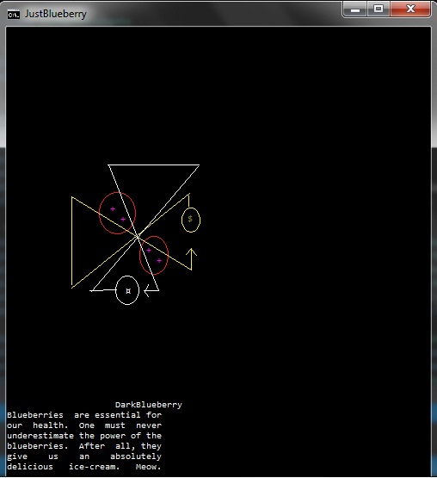
How does it work…

Slide 6
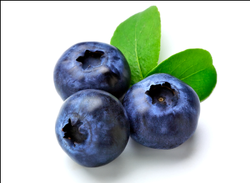
TEAM BLUEBERRY
Васил Динев
Константин Попов
Мария Качарава
Кристиян Терзиев
Александър Марков
Ивайло Петров
Илия Беличев
Димитър Гайдарджиев
Github repository

